Slide 1
COMSOL Modeling Results and Tutorial
Daniel Grass

Slide 2
Models
Noise from the Bulk Thermal Modes of the End Mirrors
Ability to change the Radius of Curvature of a Filter Cavity Mirror
Ability to correct for Astigmatism and other Higher Order Modes due to Coating Stress in the End Mirrors

Slide 3
Bulk Thermal Noise Starting Point
Have an Approximate Analytic Model
Assumptions:
Mirror is Rectangular Prism
Orthogonality Assumption of Bulk Modes
Low Q bath doesn’t couple into Mirror
Most Worried about how Acoustic Longitudinal Etalon Bulk Modes of the Mirror Couple into the Rest of the Modes Between hem

Slide 4
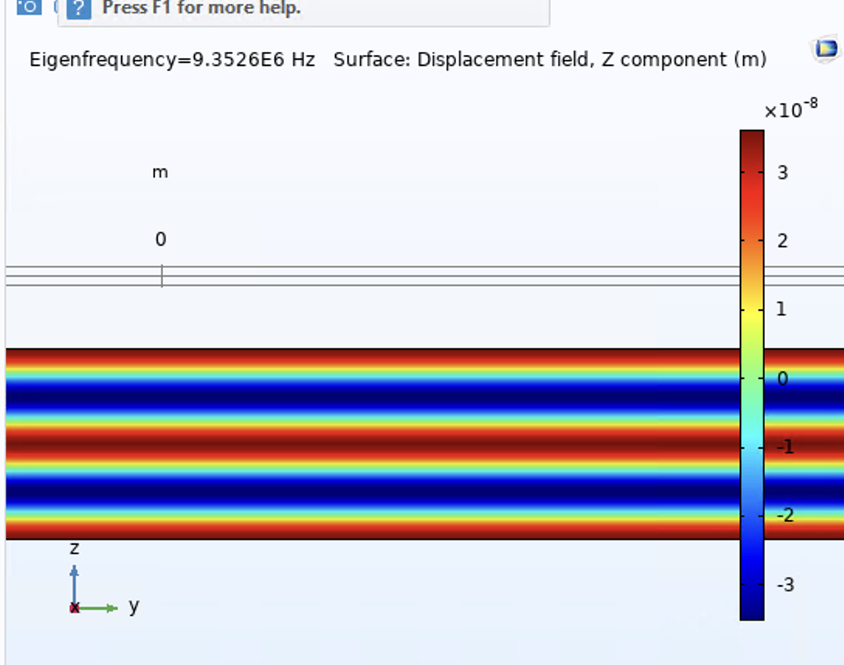
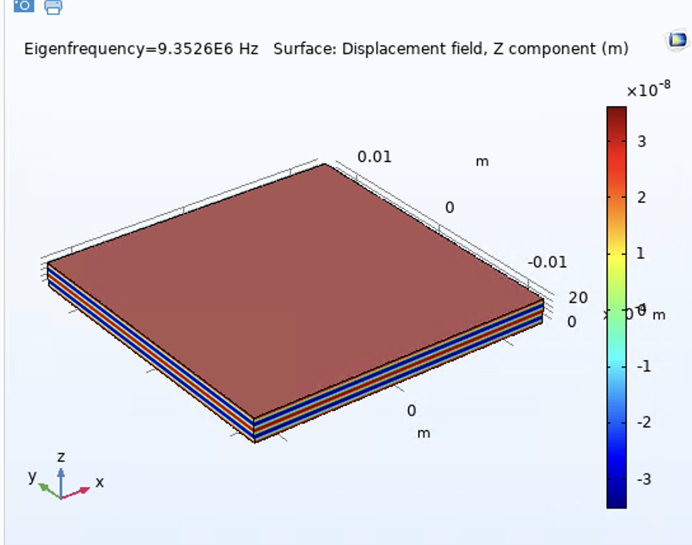
Acoustic Longitudinal Etalon Bulk Modes
4th Acoustic Longitudinal Etalon Bulk Mode shown
Full Coupling into the laser

Slide 5
How to get spectrum
Eigenmode Decomposition
Direct
Can apply different laser parameters with one simulation
Takes too long in the MHz band, even with LIGO server
Requires every mode
Susceptibility
More indirect
Each Simulation only useful for Single Laser Parameter Set
But ultimately able to be computed in a reasonable time

Slide 6
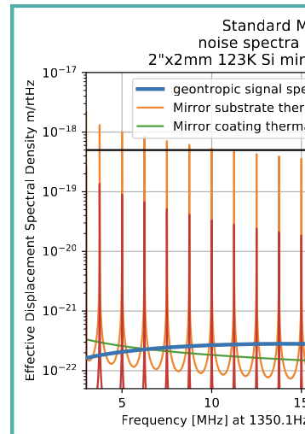
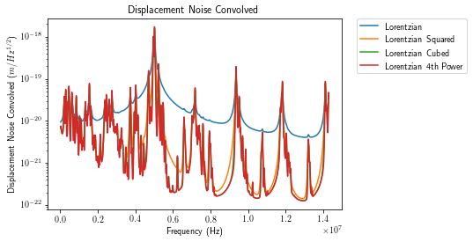
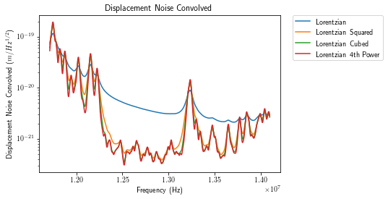
Results
Square Mirror Analytic
Square Mirror COMSOL
Circular Mirror COMSOL

Slide 7
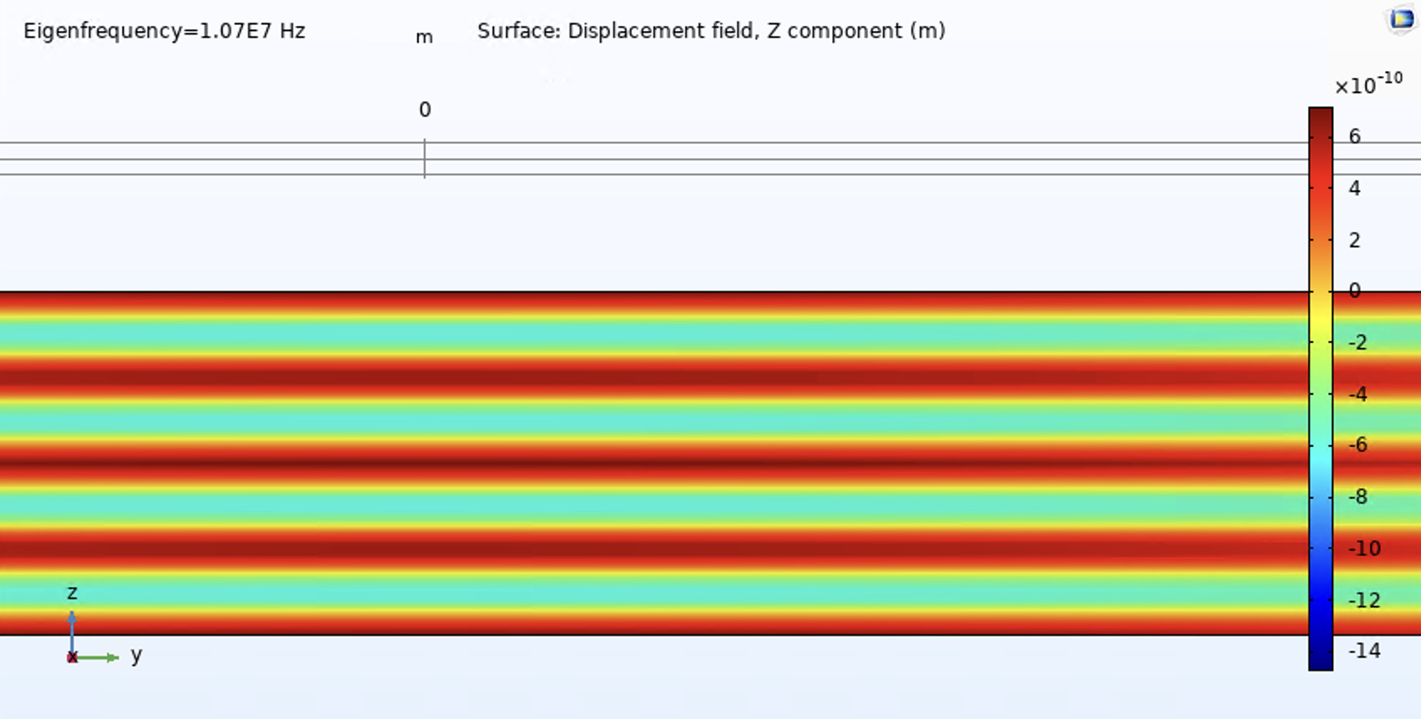
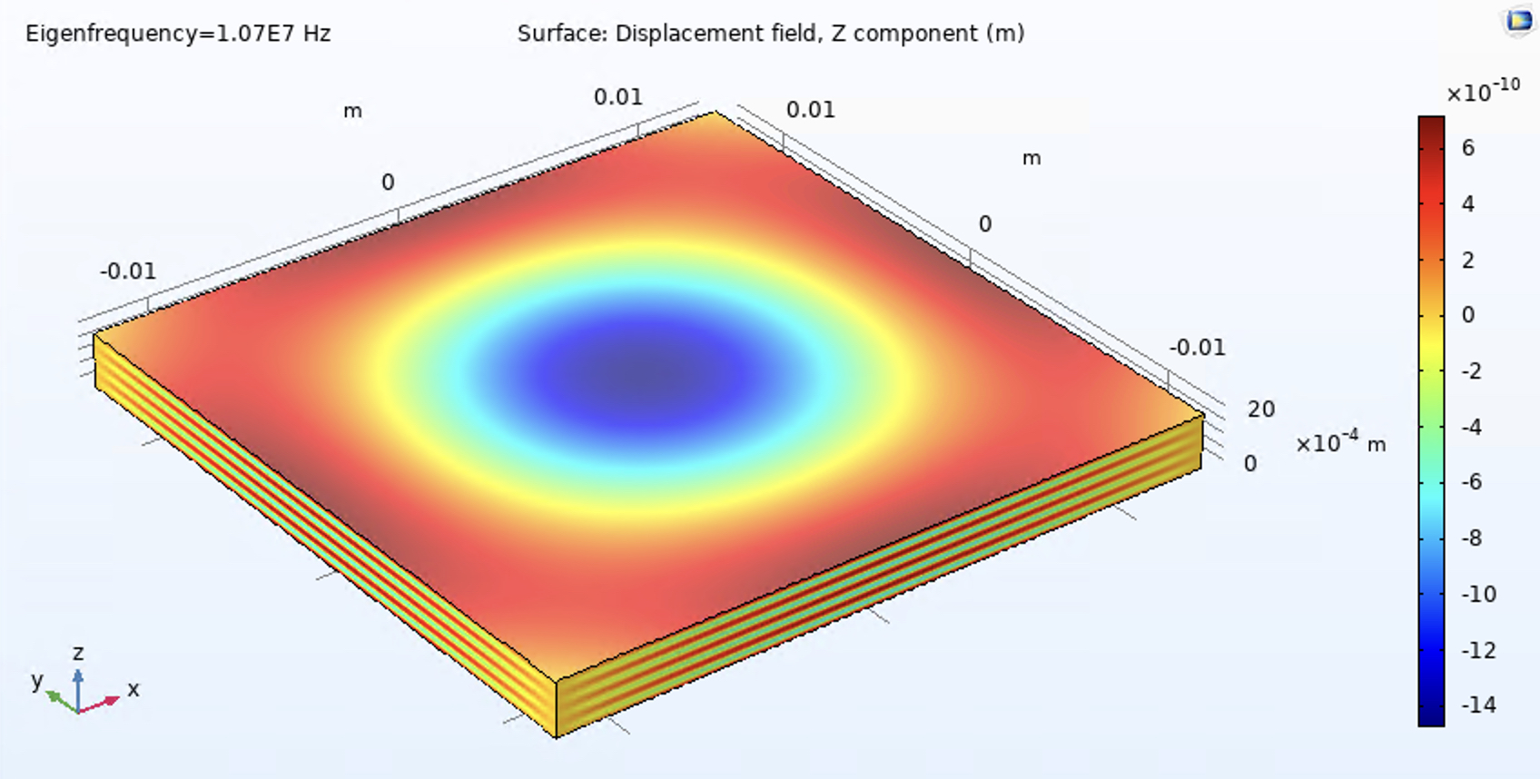
Problematic Half Acoustic Mode

Slide 8
Radius of Curvature Pusher
“The CRUSHER”
Don’t want Higher Order Hermite-Gauss Modes of the Carrier to Leak through the Filter Cavities
Want to Continuously Change the Gouy Phase to Prevent This

Slide 9
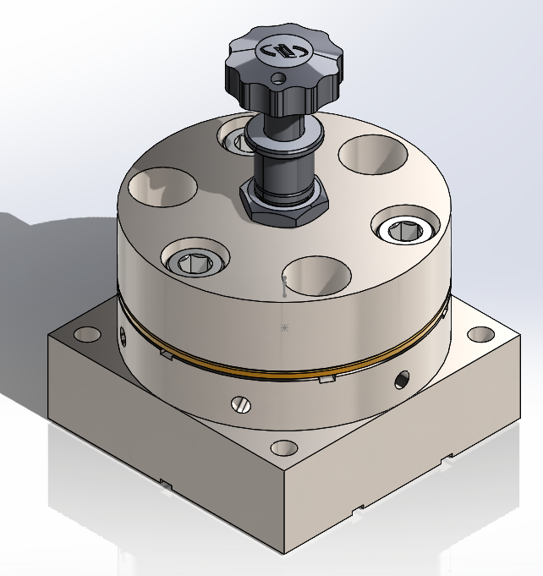
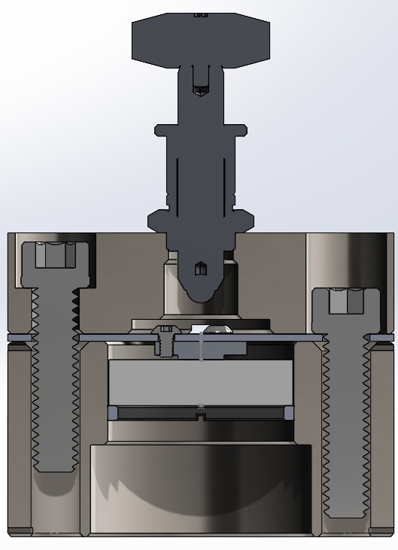
The Design

Slide 10
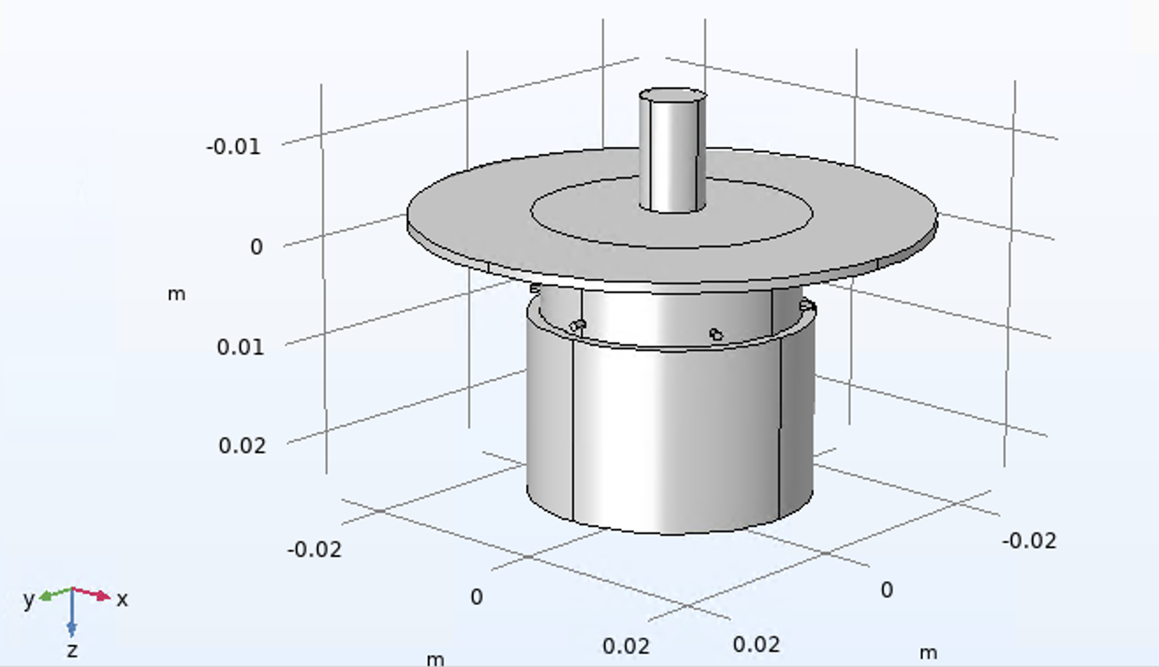
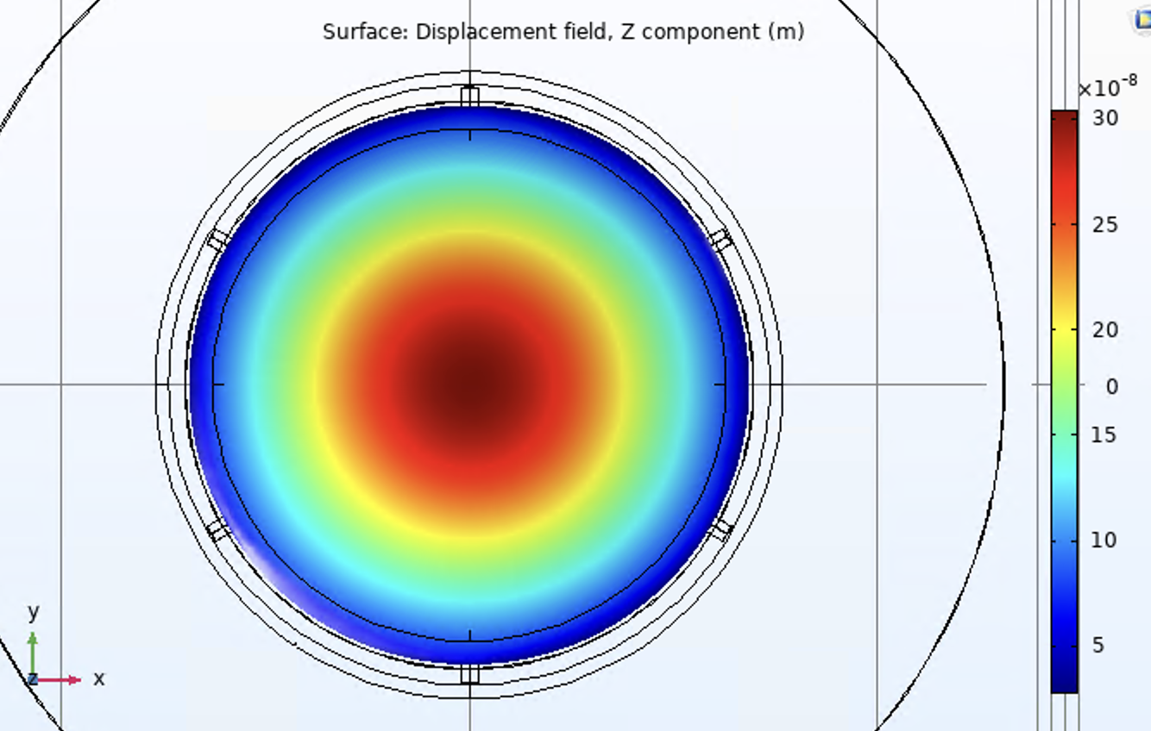
The Model

Slide 11
Results
Export Wavefront Integration as .tex for Python Code
55 N of force change the radius of curvature by 10 mDiopters
Relatively robust against misalignment

Slide 12
Astigmatism Correction
Need Thin Optic to space out the Acoustic Longitudinal Etalon Bulk Modes
The Optic is Less Stiff and the Wavefront gets Distorted by the Coating Stress
Need Flat Mirror to reduce the Contrast Defect of the Interferometer to Photon Count

Slide 13
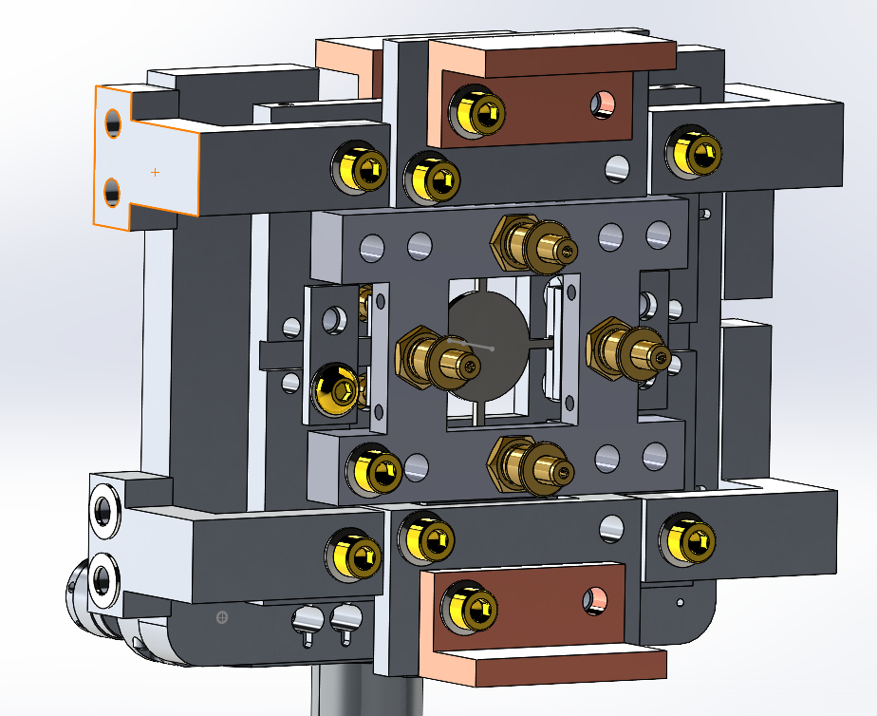
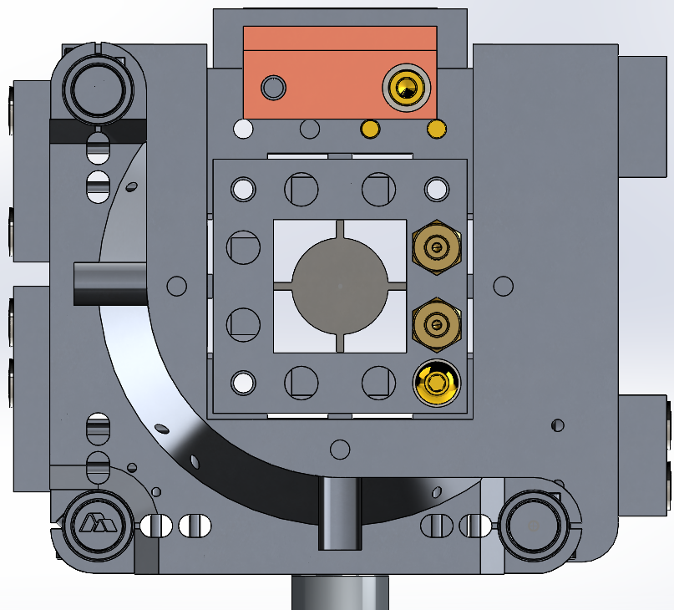
The Design

Slide 14
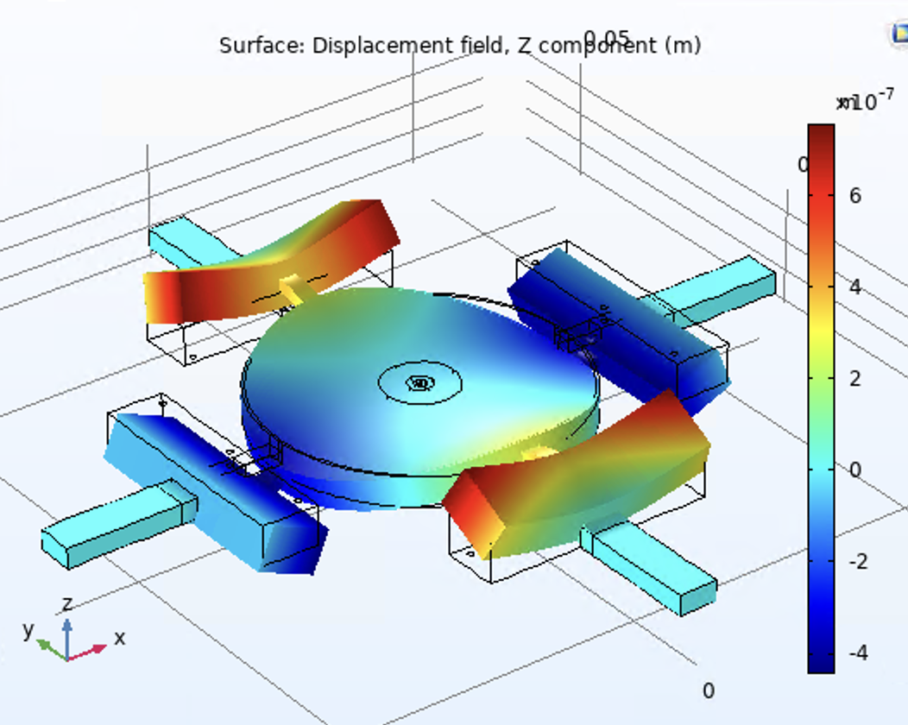
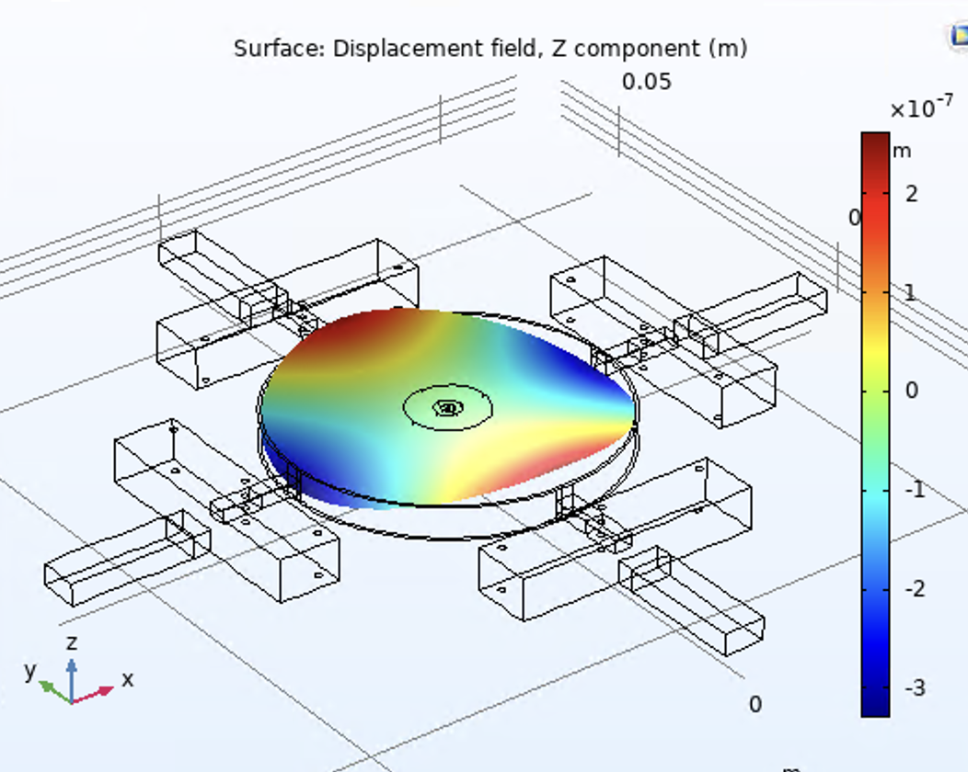
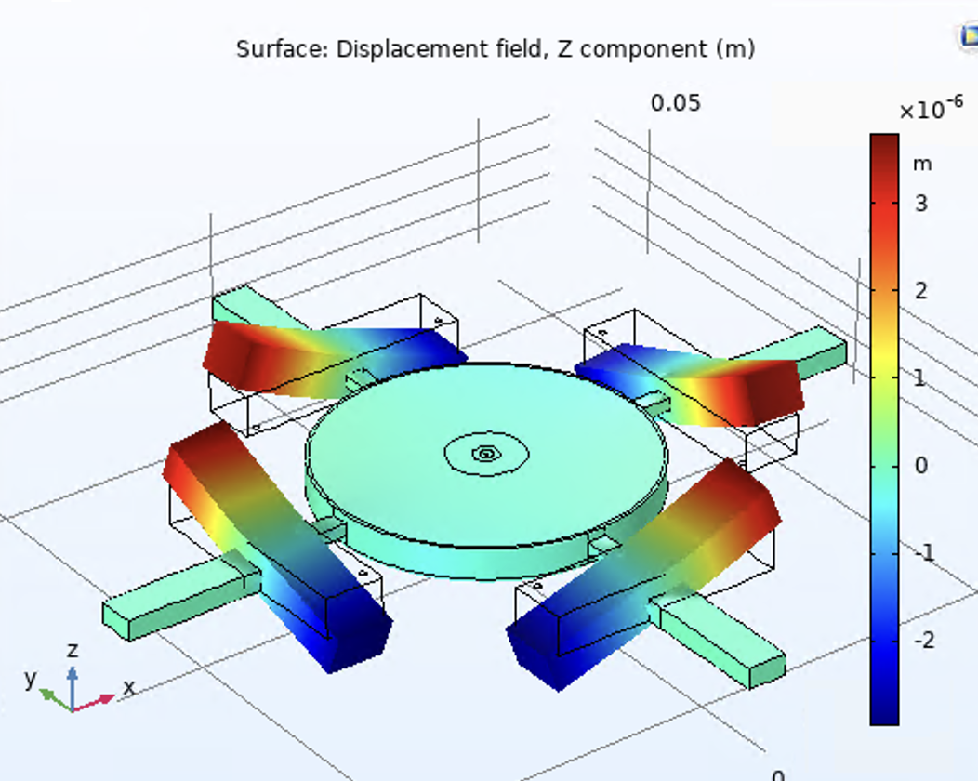
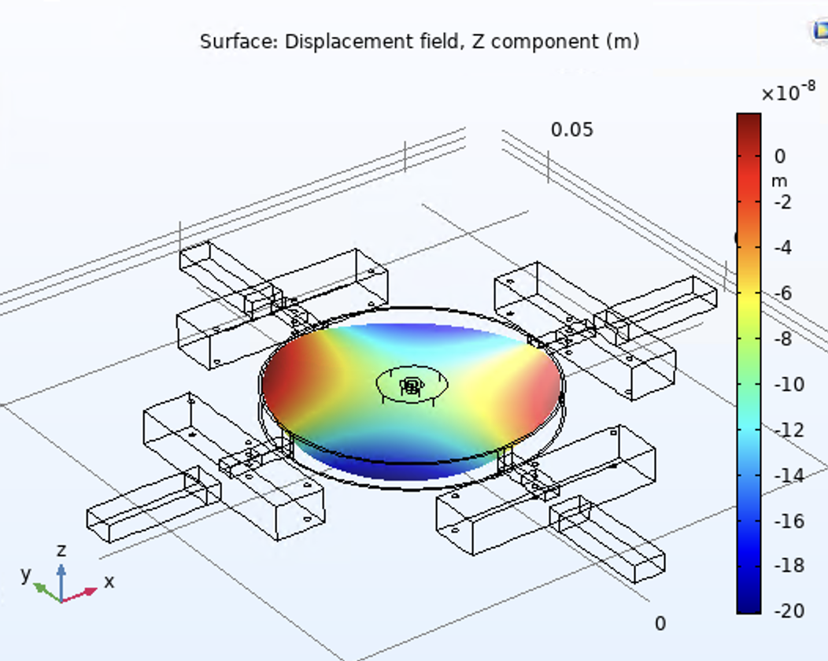
The Model

Slide 15
Results
Export Wavefront Integration as .tex for Python Code
3 Modes we care about and can Easily Address: 02 + 20, 02 -02, 11
We hope to Address all these Modes with under 50 N of force
Need a Better Understanding of the Coating to model the Correction Needed
02 + 20 mode somewhat Weakly Addressed
Cause for Some Concern
Model Looked at Stress at Optical Bond Site
Could be Limited by Breaking the Optical Bond

